Slide 1
Miscellaneous Credits
Pub 4012 Tab G
Pub 17 Part 6
(Federal 1040-Lines 51, 53 & 54)
Notes:
1

Slide 2
Review: Nonrefundable Credits
Dollar for dollar reduction of tax liability
Applied against federal tax in the order they are listed on Federal 1040 Page 2 credits
Amount of credit could change in TaxSlayer if entry of a credit on prior line causes nonrefundable credits to exceed tax liability
Can reduce tax liability to zero
Note: Refundable credits covered elsewhere
Notes:
2

Slide 3
Nonrefundable Credits
Education Credits – 1040 Line 50
Must be entered at end of return after all other figures finalized, so covered in a later module
Retirement Savings Contributions Credit – 1040 Line 51
Residential Energy Credits – 1040 Line 53
Credit for the Elderly or Disabled – 1040 Line 54
Others which are Out Of Scope –
Alternative Motor Vehicle Credit
Mortgage Interest Credit
Notes:
3

Slide 4
Retirement Savings Contribution Credit
Pub 4012 Tab G
Credit for contributing to a retirement plan - IRA, 401k, 403b, 457b, etc.
Amount of credit based on AGI & filing status
TaxSlayer automatically inserts Form 8880, if taxpayer qualifies and if:
Traditional or Roth IRA contribution is entered on Federal 1040 Line 32 OR
Form W-2 includes retirement contribution in Box 12 with a code designation of D, E, F, G, H, S, AA, BB or in Box 14 marked as “Retirement (Not in Box 12) – Carry to Form 8880”
Notes:
414h Withholding does not count for Retirement Savings Credit. 414h plans mandate “employee contributions” which the employer then pays. Not included in taxable wages, so taxpayer already gets a tax benefit. Therefore, cannot also take a Retirement Savings Contribution Credit
4

Slide 5
Retirement Savings Contribution Credit
Pub 4012 Tab G
(cont’d)
2015 contribution reduced by any retirement plan distributions to taxpayer after 2012 thru due date of 2015 return (IRA, Roth, 401k, etc.) *
Must complete Form 8880
Enter in Federal Section \ Deductions \ Enter Myself \ Credits Menu \ Retirement Savings Credit (Form 8880)
TaxSlayer completes rest of form
TS calculates credit on Form 8880 Line 12 & transfers to Federal 1040 Line 51
* Consult Pub 4012 Tab G to determine which retirement plan distributions to include/exclude
Notes:
5

Slide 6
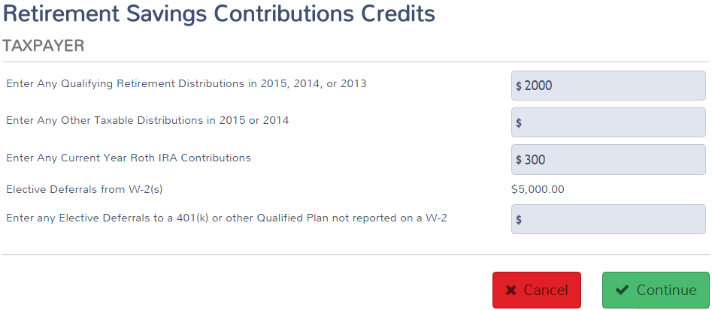
TS - Retirement Savings Contribution Credit – Form 8880 Federal Section \ Deductions \ Enter Myself \ Credits Menu \ Retirement Savings Credit (Form 8880)
Pub 4012 Tab G
Enter as appropriate
TS transfers from other entries
Notes:
6

Slide 7
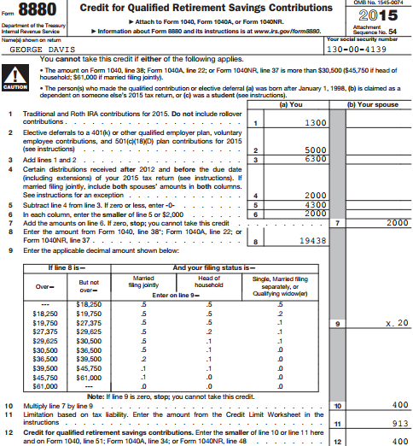
TS - Retirement Savings Contribution Credit – Form 8880
Pub 4012 Tab G
Retirement savings contribution credit
Notes:
7

Slide 8
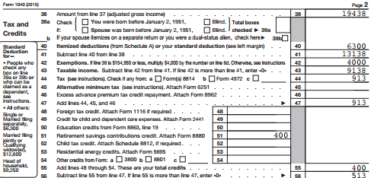
TS – Retirement Savings Credit - 1040 Line 51
TS transfers from Schedule 8880 Line 12
Notes:
TS transfers Retirement Savings Credit from Schedule 8880 Line 12 to 1040 Line 51
8

Slide 9
Residential Energy Credits
Applies to qualified energy efficiency improvements
Insulation, windows & doors, qualifying metal / asphalt roofs (does not include labor costs)
Most standard new roofs are NOT qualifying roofs
Heating & air conditioning systems (includes labor costs)
See Form 5690 for complete list of items
Improvements made to principal residence only (must be existing home, not new)
Improvements must have been placed into service in current tax year
Notes:
9

Slide 10
Residential Energy Credits
(cont’d)
Total combined credit limit of $500 for all years after 2005 ($200 for windows)
Maximum credits:
$50 for advanced main air circulating fan
$150 for natural gas, propane, oil furnace
$150 for hot water boiler
$200 for windows
$300 for any item of energy-efficient building property
Notes:
10

Slide 11
Residential Energy Credits
(cont’d)
Credit taken on Form 5695, Part II
Form 5695, Part I, Out of Scope
For alternative energy equipment, such as solar hot water heaters, geothermal heat pumps, & wind turbines
Enter in Federal Section \ Deductions \ Enter Myself \ Credits Menu \ Residential Energy Credit (Form 5695)
NOTE: Not all ENERGY STAR products qualify for credit. Manufacturers must certify & provide written statement
Notes:
11

Slide 12
TS – Form 5695 Sub-Menu Federal Section \ Deductions \ Enter Myself \ Credits Menu \ Residential Energy Credit (Form 5695)
Check if improvements made to main home in US;
Must be checked to qualify for credit
Used for our clients
Check if improvements related to home construction;
Would not qualify for credit if checked
Out of Scope
Notes:
Read & answer questions carefully on Form 5695
12

Slide 13
TS - Residential Energy Credits – Form 5695 Federal Section \ Deductions \ Enter Myself \ Credits Menu \ Residential Energy Credit (Form 5695)
Check if improvements made to main home in US;
Must be checked to qualify for credit
Check if improvements related to home construction;
Would not qualify for credit if checked
Notes:
Read & answer questions carefully on Form 5695
13

Slide 14
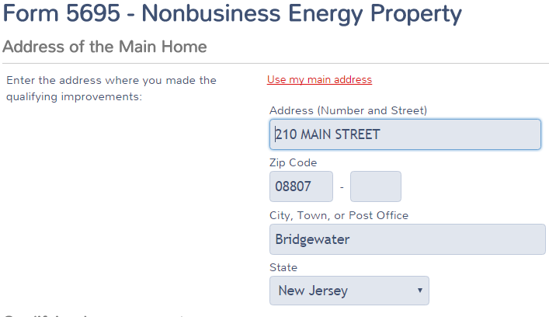
TS - Residential Energy Credits – Form 5695 Federal Section \ Deductions \ Enter Myself \ Credits Menu \ Residential Energy Credit (Form 5695) \ Nonbusiness Energy Property
Check to use address from Basic Information section; TS enters address
Enter to use other than address
in Basic Information section
Notes:
14

Slide 15
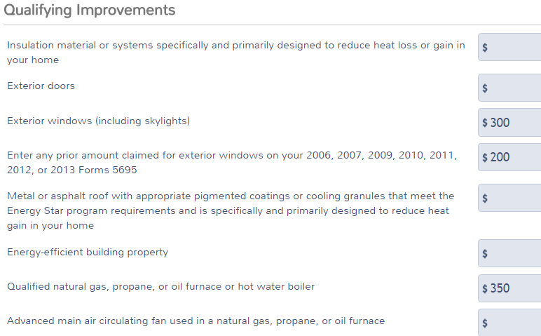
TS - Residential Energy Credits – Form 5695 Federal Section \ Deductions \ Enter Myself \ Credits Menu \ Residential Energy Credit (Form 5695) \ Nonbusiness Energy Property
Enter amount for improvements on appropriate line
Notes:
15

Slide 16
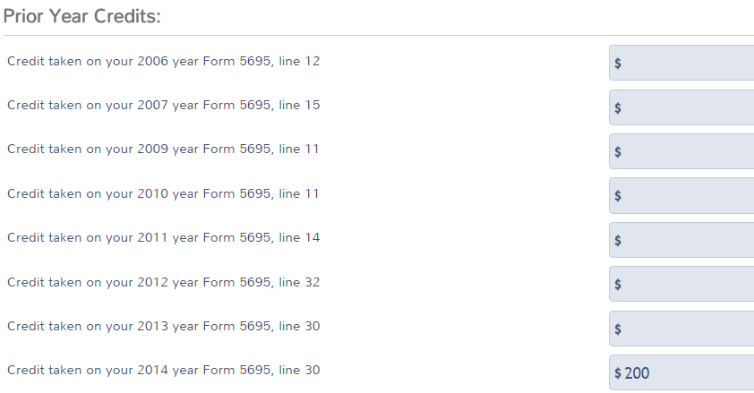
TS - Residential Energy Credits – Form 5695 Federal Section \ Deductions \ Enter Myself \ Credits Menu \ Residential Energy Credit (Form 5695) \ Nonbusiness Energy Property
Enter credits taken in prior years
Notes:
16

Slide 17
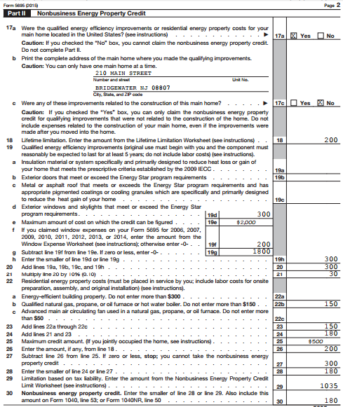
TS - Residential Energy Credit – Form 5695 Part II
Residential energy credit
Notes:
TS calculates the residential energy credit on Form 5695 Line 30
17

Slide 18
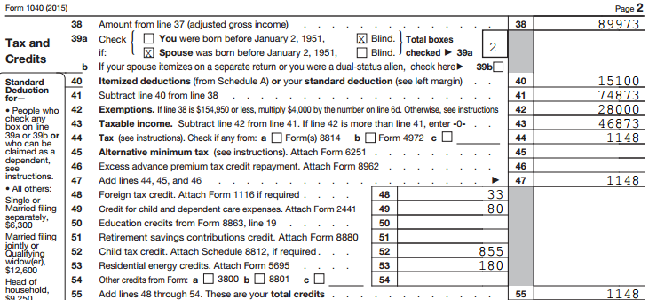
TS - Residential Energy Credit – 1040 Line 53
TS transfers from Form 5695
Notes:
TS transfers Form 5695 Line 30 to 1040 Line 53
18

Slide 19
Eligibility for Credit For The Elderly or Disabled
Pub 4012 Tab G
At least 65
If under 65 & retired on permanent & total disability & did not reach mandatory retirement age - must have taxable disability income
Must meet income limits for AGI & non-taxable SS/pension benefits – dependent on filing status
Rare due to severe income limitations
Requires Schedule R
TS computes automatically if correct data is input
Refer to Pub 4012 Page G-11
Notes:
Refer to Pub 4012 Page G-11 for eligibility decision tree & income limits chart
19

